Slide 1
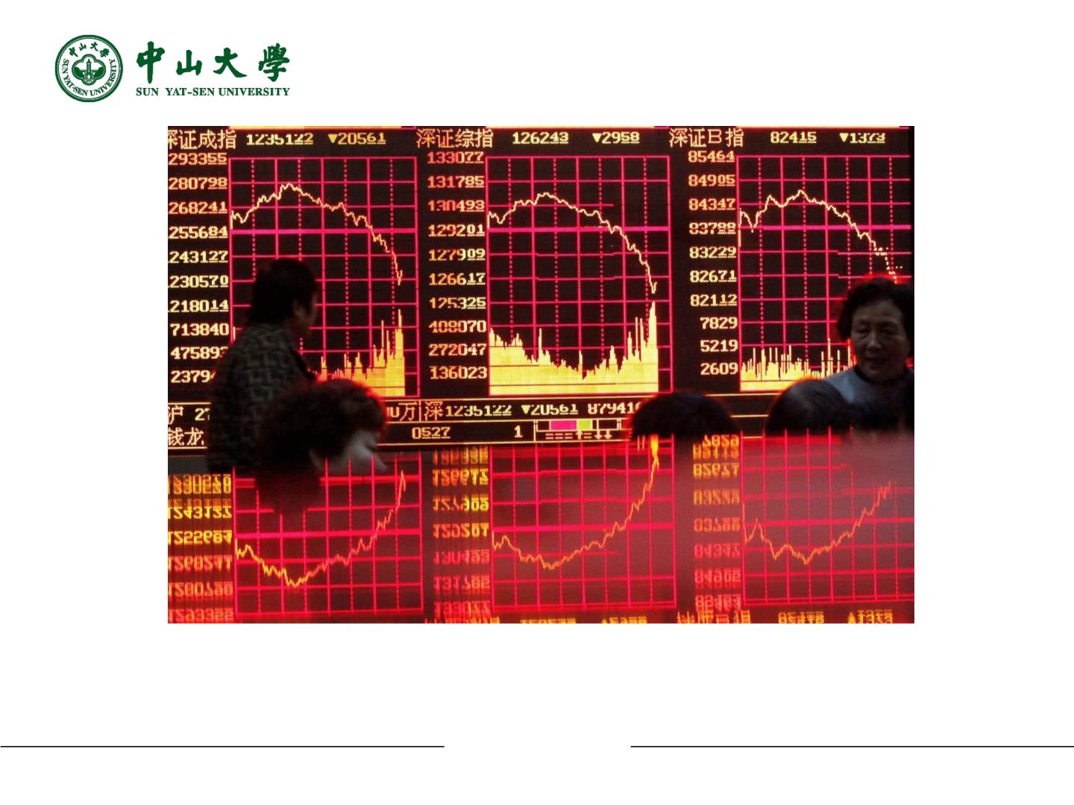
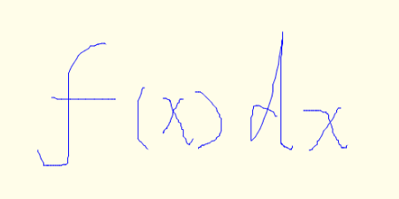
Overview of Mathematical Expression Recognition
(ICPRAI 2020)
Jiashu Huang
Jun Tan
Ning Bi
(Sun Yat-Sen University)
2020.10
Jiashu Huang, Jun Tan, Ning Bi
1

Slide 2

Outline
Mathematical Expression (ME for short) Recognition
Ⅰ Major Problems
Ⅱ Research Status
Ⅲ Future
2020.10
Jiashu Huang, Jun Tan, Ning Bi
2

Slide 3
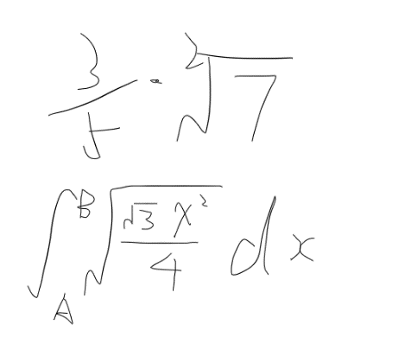
Ⅰ Major Problems
Symbol segmentation
2020.10
Jiashu Huang, Jun Tan, Ning Bi
3

Slide 4
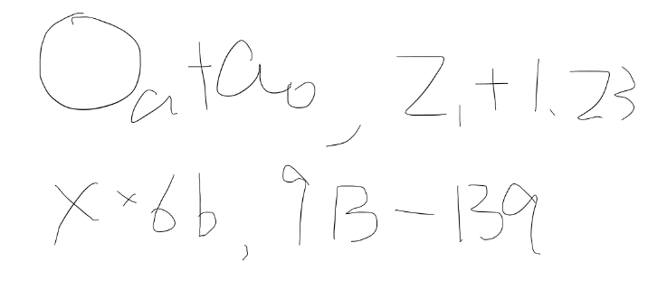
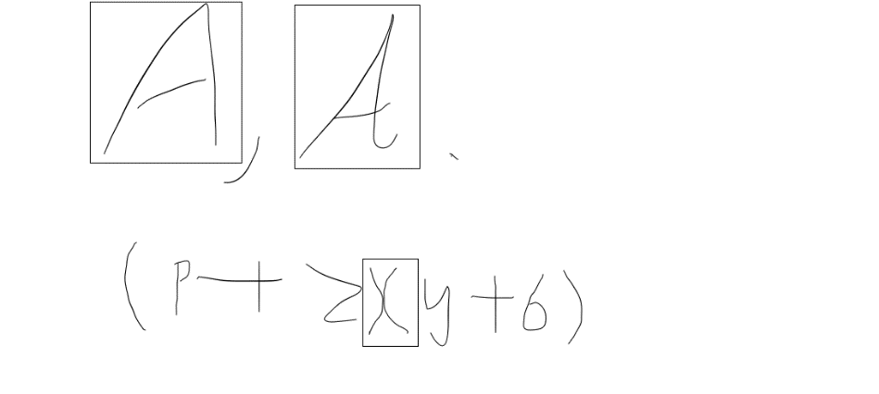
Ⅰ Major Problems
Symbol recognition
Fig. 2. Some examples of the local ambiguity of mathematical expression. The mathematical
expressions are: ①$O_{a}+a_{0}$;②$z_{1}+1.23$;③$x×6b$;④$9B−13q$.
2020.10
Jiashu Huang, Jun Tan, Ning Bi
4

Slide 5
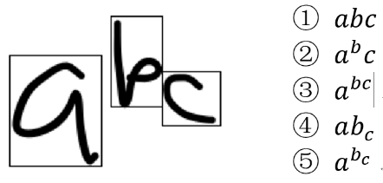
Ⅰ Major Problems
Structure analysis
2020.10
Jiashu Huang, Jun Tan, Ning Bi
5

Slide 6
Ⅱ Research Status
Document ME recognition research status
Author | Main Contribution or Method
Ha et al. [5] | A recursive X-Y cut segmentation method
Kumar et al. [6] | A rule-based approach, connected components
Kim et al. [7] | A modified recursive projection profile cutting method, depth first search
Murru et al. [8] | ANN, backpropagation algorithm
2020.10
Jiashu Huang, Jun Tan, Ning Bi
6

Slide 7
Ⅱ Research Status
Handwritten ME recognition research status
Author | Main Contribution or Method
Hirata et al. [9] | Formulated matching as a graph matching problem
MacLean et al. [10][11] | ①Relational grammars and fuzzy sets. ②Bayesian networks for parse tree selection.
Simistira et al. [12] | Symbolize the elastic template matching distance
Álvaro et al. [13] | Two-dimensional stochastic context-free grammar and hidden Markov models
Awal et al. [14] | A simultaneous optimization under the restriction of a ME grammar
Hu et al. [15] | Dynamic programming, a Gaussian Mixture Model learnt through Expectation-Maximization algorithm, and a ternary tree
2020.10
Jiashu Huang, Jun Tan, Ning Bi
7

Slide 8
Ⅱ Research Status
Handwritten ME recognition research status(neural network)
Author | Main Contribution or Method
Le et al. [16][17] | ①A CNN for feature extraction, a bidirectional LSTM for encoding extracted features, an LSTM and an attention model for generating target LaTex. ②Modifies the recursive X–Y cut method.
Ting Zhang et al. [18] | Extend the chain-structured BLSTM to tree structure topology. Addresses the recognition task as a graph building problem.
Jianshu Zhang et al. [19][20] | Track, Attend and Parse(TAP), an end-to-end approach. The architecture of TAP consists of a tracker and a parser.
2020.10
Jiashu Huang, Jun Tan, Ning Bi
8

Slide 9
Ⅲ Future
With the development of computing power and algorithms, more and more research attempts to solve problems from a global perspective.
In the future, depending on the full development of computing power, the application of deep learning for research may have good prospects.
2020.10
Jiashu Huang, Jun Tan, Ning Bi
9

Slide 10

Jiashu Huang, Jun Tan, Ning Bi
10

